Slide 1
Data Structures ICT-1211 Information and Communication Technology
Lecture-06
Date:

Slide 2
String Processing

Slide 3
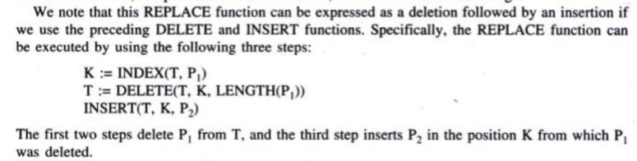
Word Processing
Replacement:

Slide 4
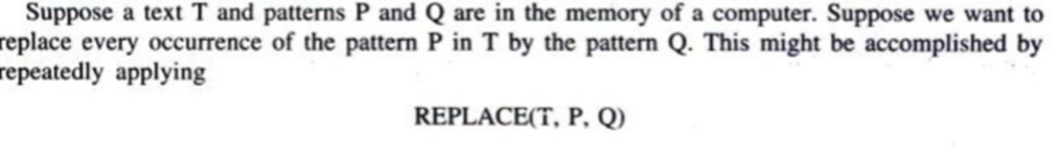
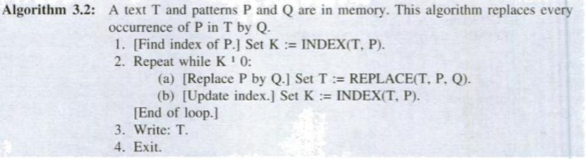
Word Processing
Replacement:

Slide 5
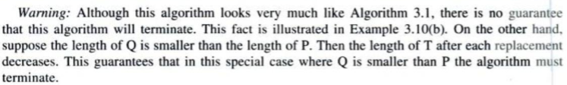
Word Processing
Replacement:

Slide 6
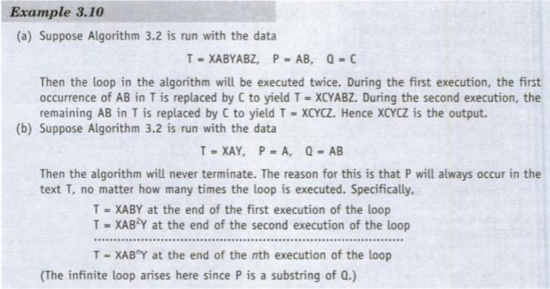
Word Processing
Replacement:

Slide 7
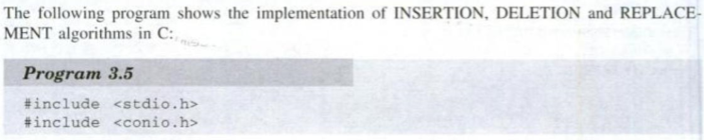
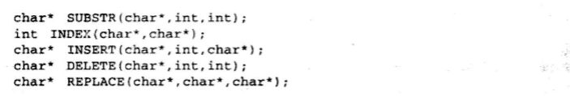
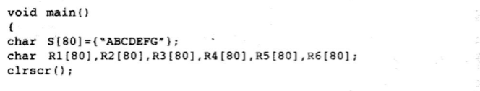
Word Processing

Slide 8
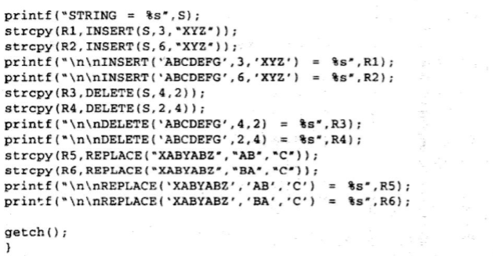
Word Processing

Slide 9
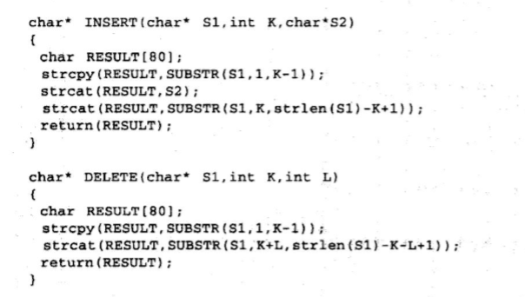
Word Processing

Slide 10
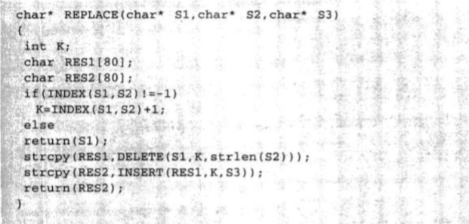
Word Processing

Slide 11
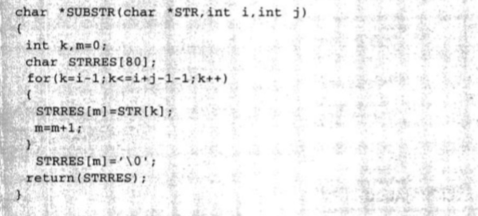
Word Processing

Slide 12
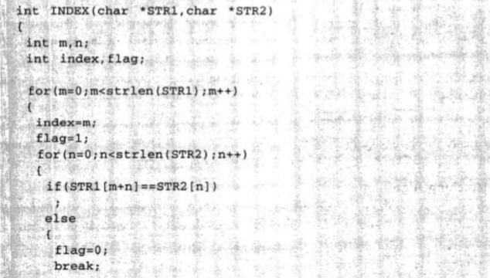
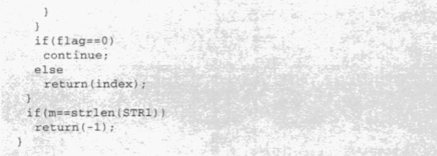
Word Processing

Slide 13
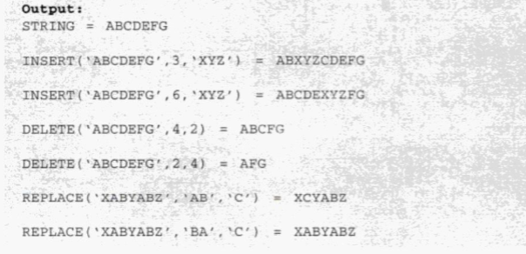
Word Processing

Slide 14
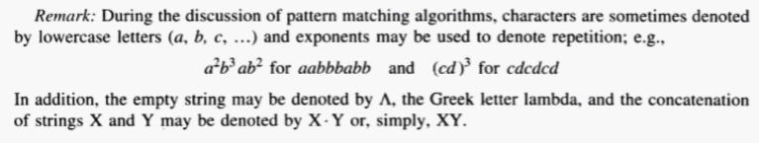
Pattern Matching Algorithms
Pattern matching is the problem of deciding whether or not a given string pattern P appears in a string text T. We assume that the length of P does not exceed the length of T.

Slide 15
Types of Pattern Matching Algorithms
First Pattern Matching Algorithm which is also known as Slow Pattern Matching Algorithm.
Second Pattern Matching Algorithm which is also known as Fast Pattern Matching Algorithm.

Slide 16
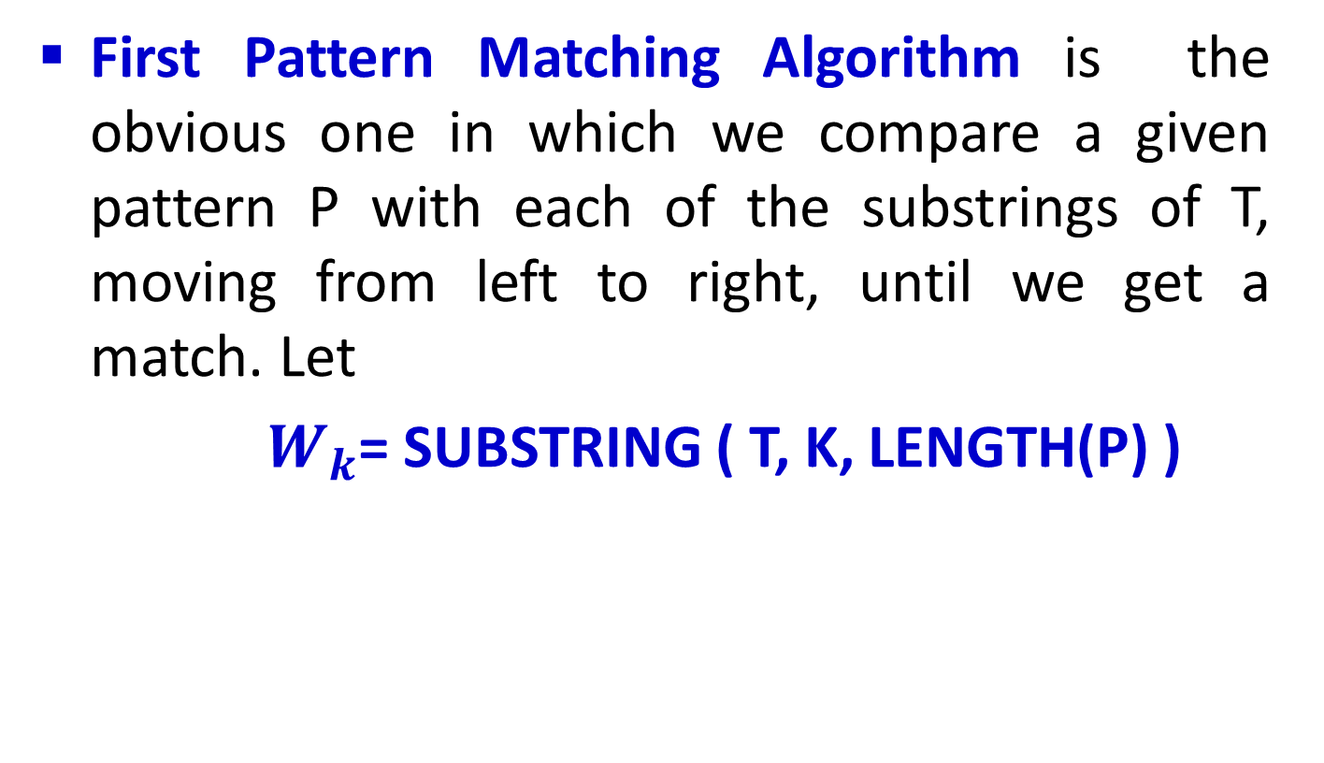
First Pattern Matching Algorithms
First Pattern Matching Algorithm is the obvious one in which we compare a given pattern P with each of the substrings of T, moving from left to right, until we get a match. Let
$W_{k}$= SUBSTRING ( T, K, LENGTH(P) )

Slide 17
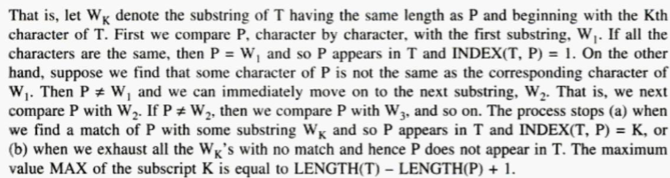
First Pattern Matching Algorithms

Slide 18
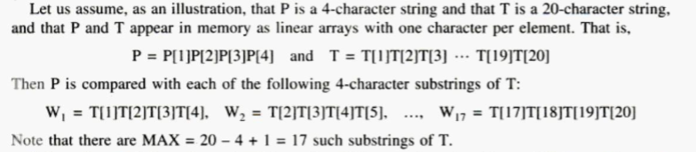
First Pattern Matching Algorithms

Slide 19
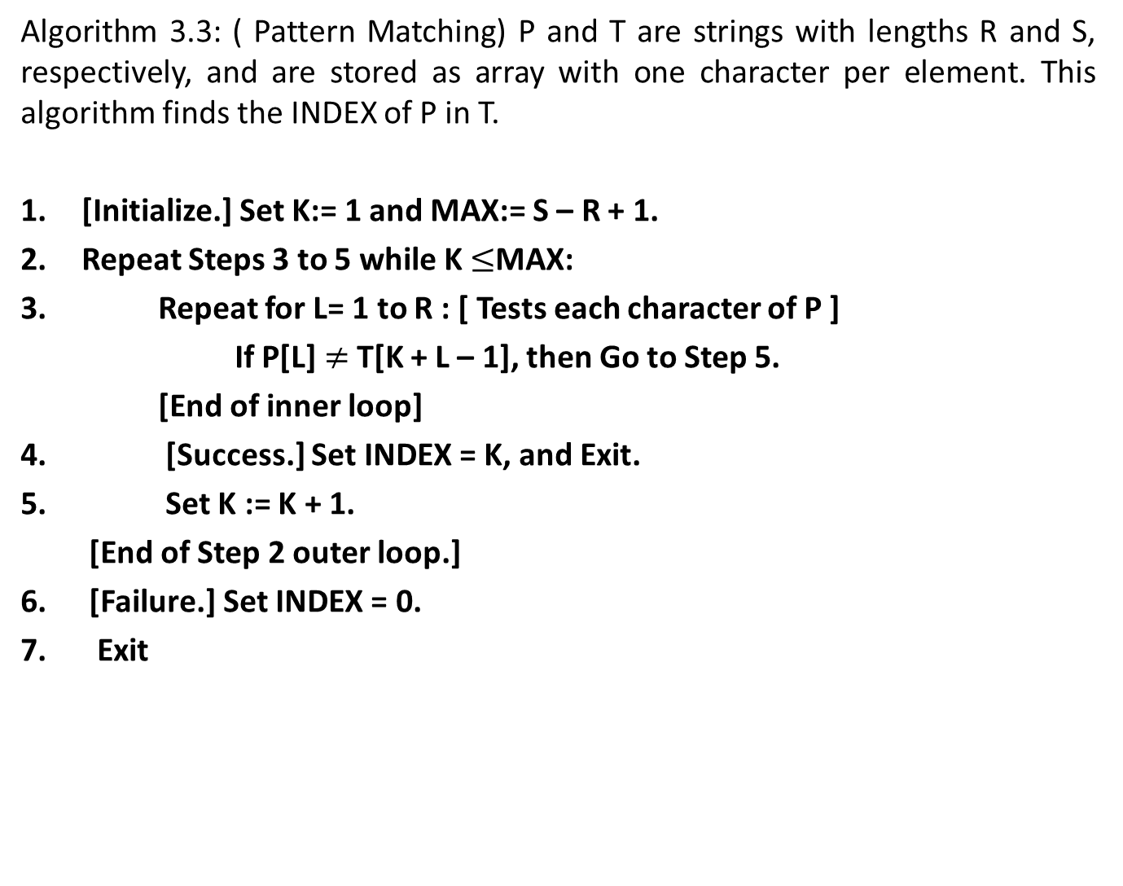
First Pattern Matching Algorithms
Algorithm 3.3: ( Pattern Matching) P and T are strings with lengths R and S, respectively, and are stored as array with one character per element. This algorithm finds the INDEX of P in T.
[Initialize.] Set K:= 1 and MAX:= S – R + 1.
Repeat Steps 3 to 5 while K $≤$MAX:
Repeat for L= 1 to R : [ Tests each character of P ]
If P[L] $≠$T[K + L – 1], then Go to Step 5.
[End of inner loop]
[Success.] Set INDEX = K, and Exit.
Set K := K + 1.
[End of Step 2 outer loop.]
[Failure.] Set INDEX = 0.
Exit

Slide 20
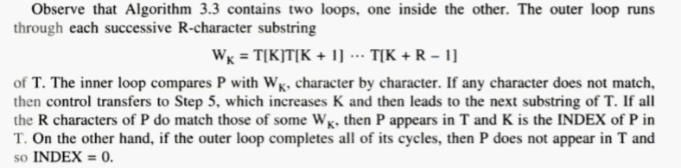
First Pattern Matching Algorithms

Slide 21
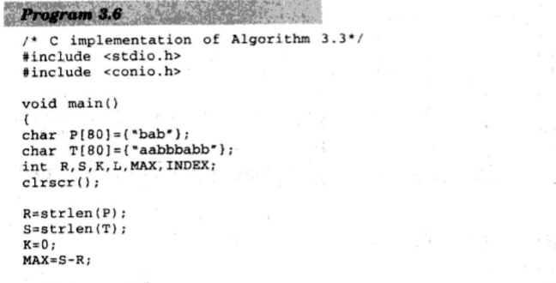
First Pattern Matching Algorithms

Slide 22
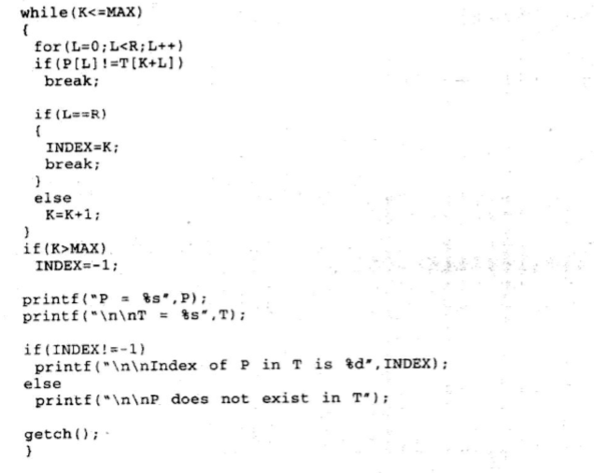
First Pattern Matching Algorithms

Slide 23
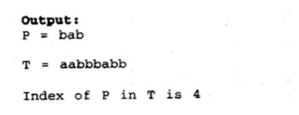
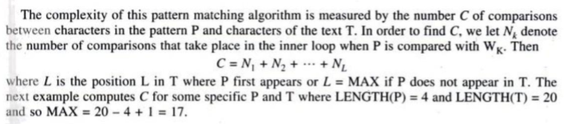
First Pattern Matching Algorithms

Slide 24
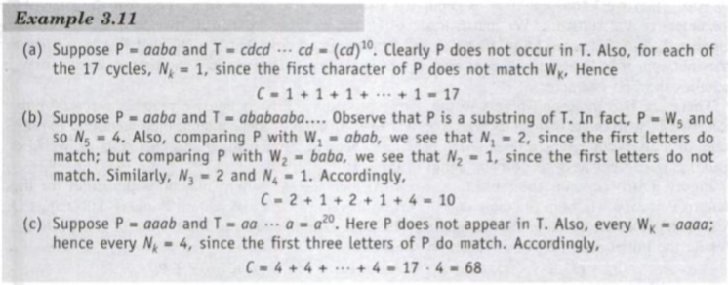
First Pattern Matching Algorithms

Slide 25
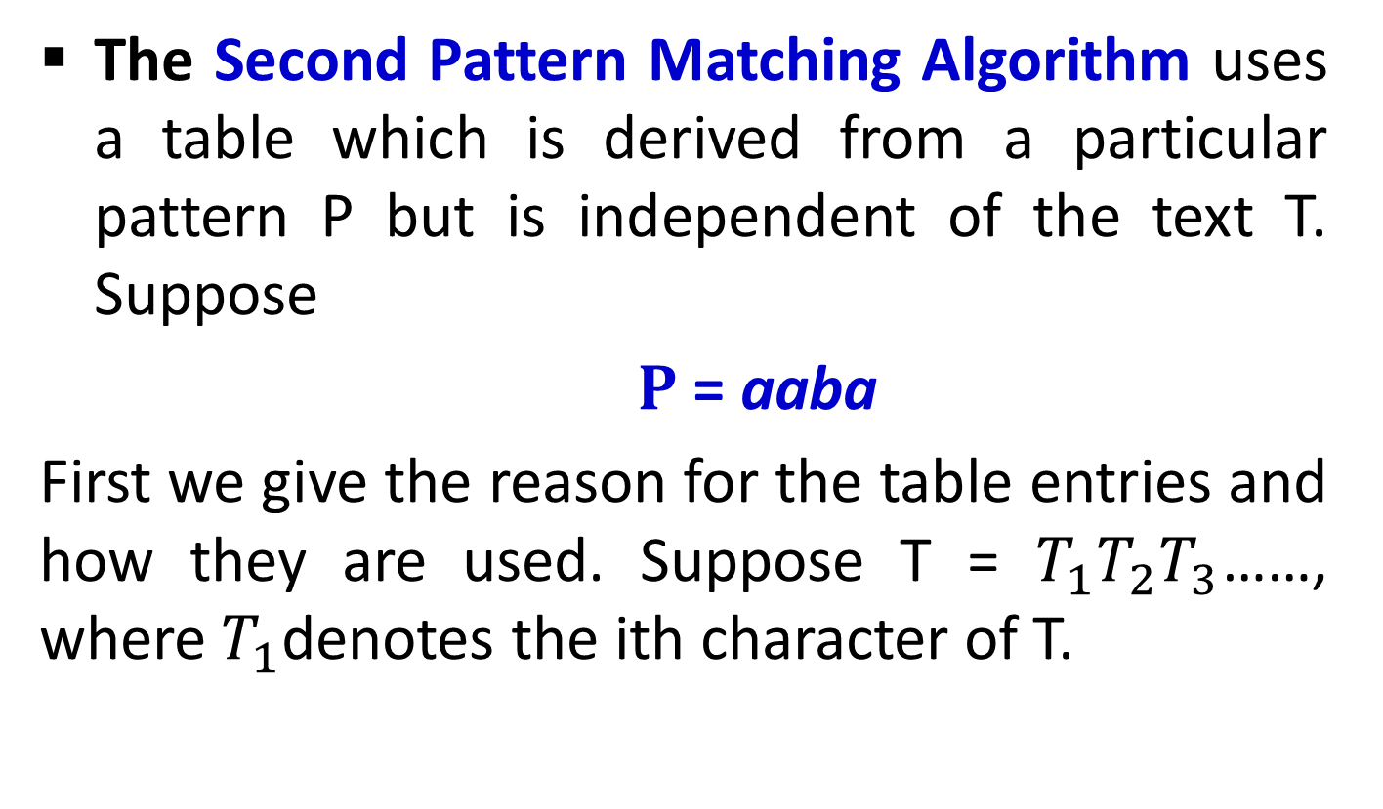
Second Pattern Matching Algorithm
The Second Pattern Matching Algorithm uses a table which is derived from a particular pattern P but is independent of the text T. Suppose
$P$ = aaba
First we give the reason for the table entries and how they are used. Suppose T = $T_{1}T_{2}T_{3}$……, where $T_{1}$denotes the ith character of T.

Slide 26
Second Pattern Matching Algorithm
Suppose the first two characters of T match those of P; i.e., suppose T = aa……..
Then T has one of the following three forms:
i. T = aab….,
ii. T = aaa….,
iii. T = aax
Where x is any character different from a or b.

Slide 27
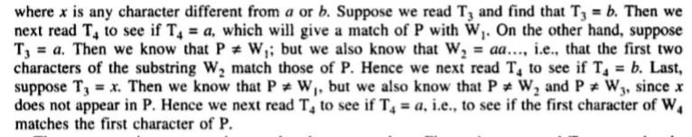
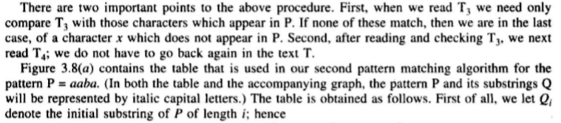
Second Pattern Matching Algorithm

Slide 28
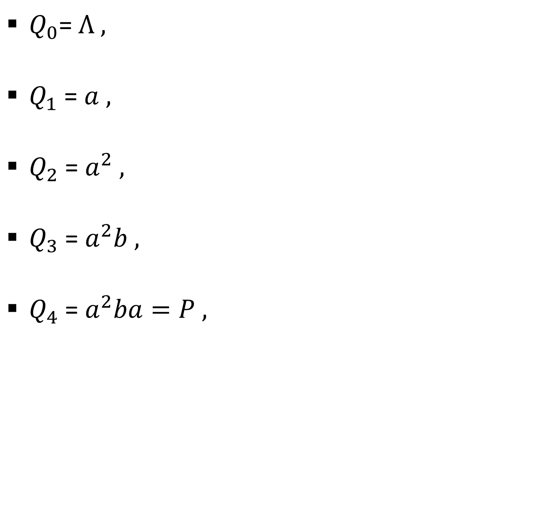
Second Pattern Matching Algorithm
$Q_{0}$= $Λ ,$
$Q_{1}$ = $a ,$
$Q_{2}$ = $a^{2} ,$
$Q_{3}$ = $a^{2}b ,$
$Q_{4}$ = $a^{2}ba=P ,$

Slide 29
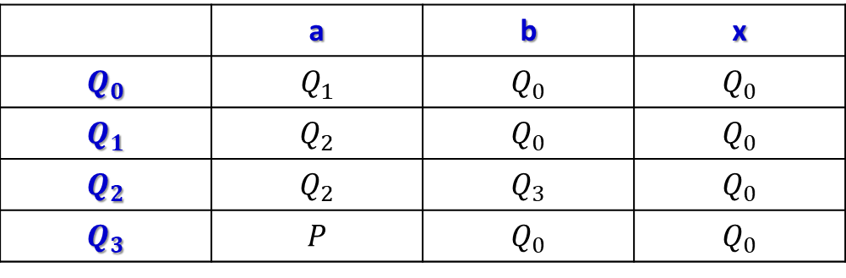

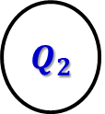


Second Pattern Matching Algorithm
 | a | b | x
$$Q_{0}$$ | $$Q_{1}$$ | $$Q_{0}$$ | $$Q_{0}$$
$$Q_{1}$$ | $$Q_{2}$$ | $$Q_{0}$$ | $$Q_{0}$$
$$Q_{2}$$ | $$Q_{2}$$ | $$Q_{3}$$ | $$Q_{0}$$
$$Q_{3}$$ | $$P$$ | $$Q_{0}$$ | $$Q_{0}$$
(a) Pattern matching table.
b
a a b a
b a
b
(b) Pattern matching graph
$$Q_{0}$$
$$Q_{1}$$
$$Q_{2}$$
$$Q_{3}$$
P

Slide 30
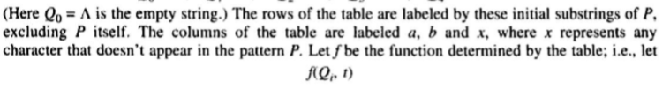
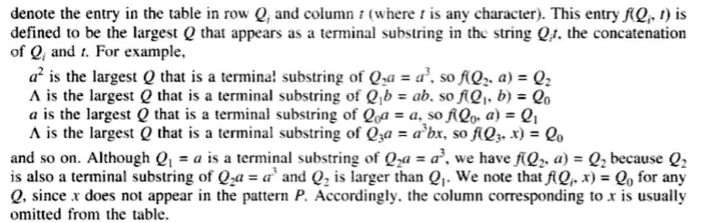
Second Pattern Matching Algorithm

Slide 31
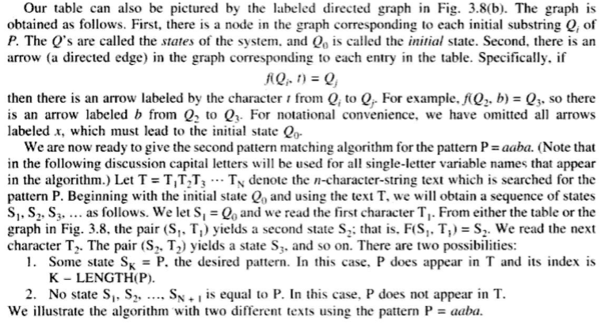
Second Pattern Matching Algorithm

Slide 32
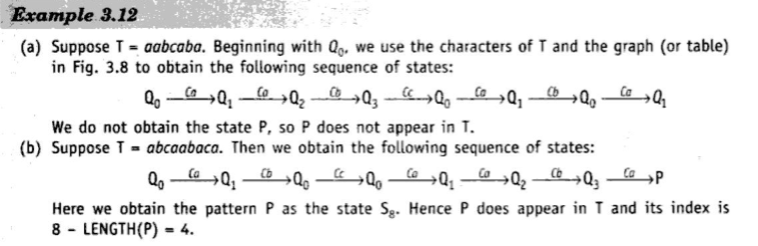
Second Pattern Matching Algorithm

Slide 33
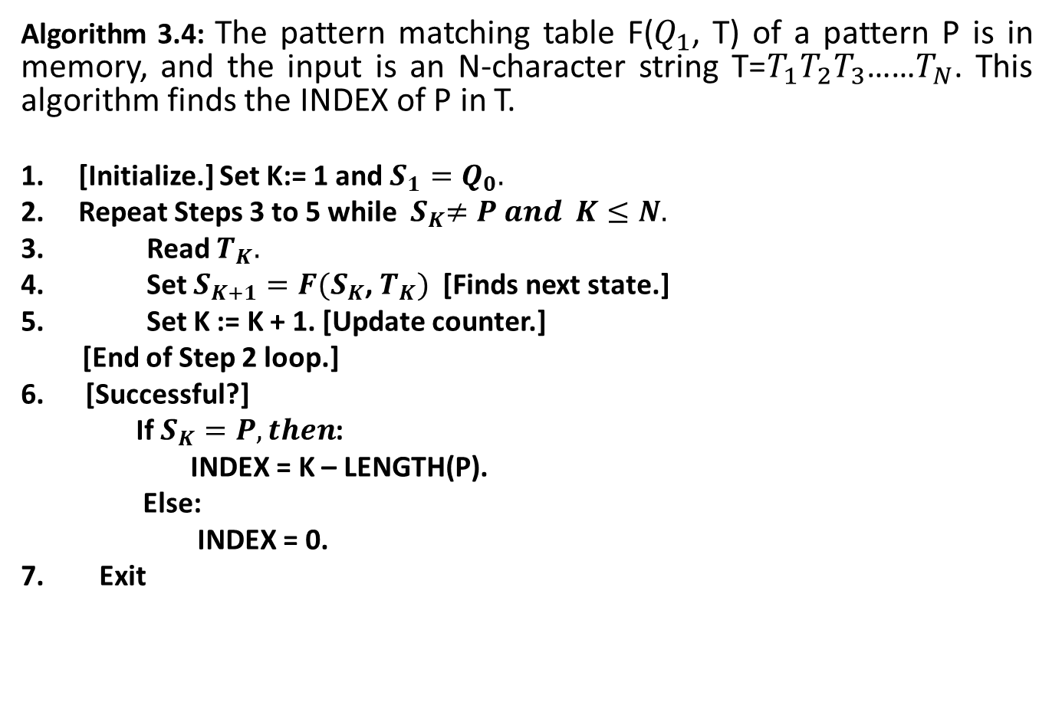
Second Pattern Matching Algorithms
Algorithm 3.4: The pattern matching table F($Q_{1}$, T) of a pattern P is in memory, and the input is an N-character string T=$T_{1}T_{2}T_{3}$……$T_{N}$. This algorithm finds the INDEX of P in T.
[Initialize.] Set K:= 1 and $S_{1}=Q_{0}.$
Repeat Steps 3 to 5 while ${ S}_{K}≠P and K≤N.$
Read $T_{K}.$
Set $S_{K+1}=F(S_{K}$, $T_{K})$[Finds next state.]
Set K := K + 1. [Update counter.]
[End of Step 2 loop.]
[Successful?]
If $S_{K}=P, then$:
INDEX = K – LENGTH(P).
Else:
INDEX = 0.
7. Exit

Slide 34
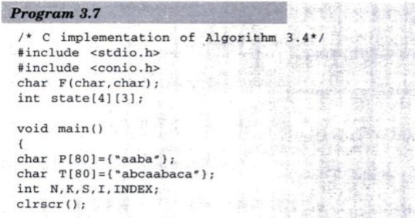
Second Pattern Matching Algorithm

Slide 35
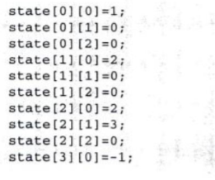
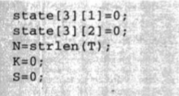
Second Pattern Matching Algorithm

Slide 36
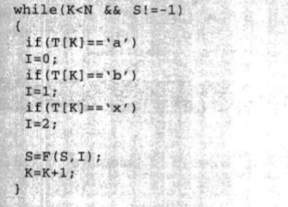
Second Pattern Matching Algorithm

Slide 37
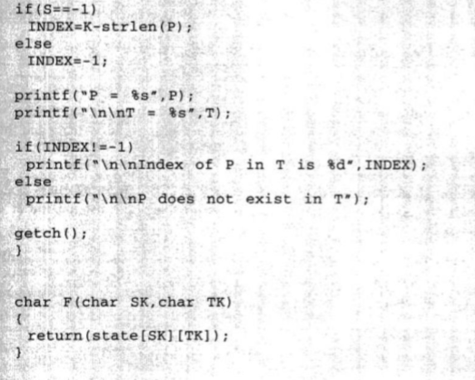
Second Pattern Matching Algorithm

Slide 38
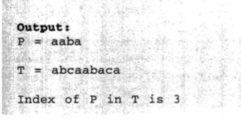
Second Pattern Matching Algorithm

Slide 39
Thank you……

